Slide 1
Batch and Online Learning
Another criterion used to classify Machine Learning systems is whether or not the system can learn incrementally from a stream of incoming data.

Slide 2
Batch learning
Batch learning is a machine learning approach where the model is trained using the entire available dataset all at once.
The learning process happens offline, meaning the system does not update itself after deployment.
Once trained, the model applies what it has learned but cannot adapt to new data unless retrained from scratch with both old and new data.

Slide 3
Key Characteristics of Batch Learning
Learning is non-incremental:
The model does not update itself when new data arrives.
Offline operation:
Training happens before deployment, often requiring significant time and computing power.
Resource-intensive:
Large datasets demand high CPU, memory, and storage resources.
Periodic retraining:
A new version of the model is trained periodically (e.g., daily or weekly) to maintain accuracy.
Automation possible:
The training–evaluation–deployment cycle can be automated for regular updates.

Slide 4
Batch learning - Example
Consider a spam email classifier:
Initially, the model is trained on a large dataset containing examples of both spam and non-spam emails.
Once trained, the system identifies spam emails based on learned patterns.
Over time, new types of spam appear. Since the model cannot learn incrementally, it must be retrained from scratch using both old and new email data.
After retraining, the updated model replaces the old one in production.

Slide 5
Batch learning
Batch learning works well when data changes slowly and computational resources are sufficient, but it becomes inefficient for scenarios requiring real-time adaptation, such as stock price prediction or online recommendation systems.
In such cases, incremental or online learning methods are preferred.

Slide 6
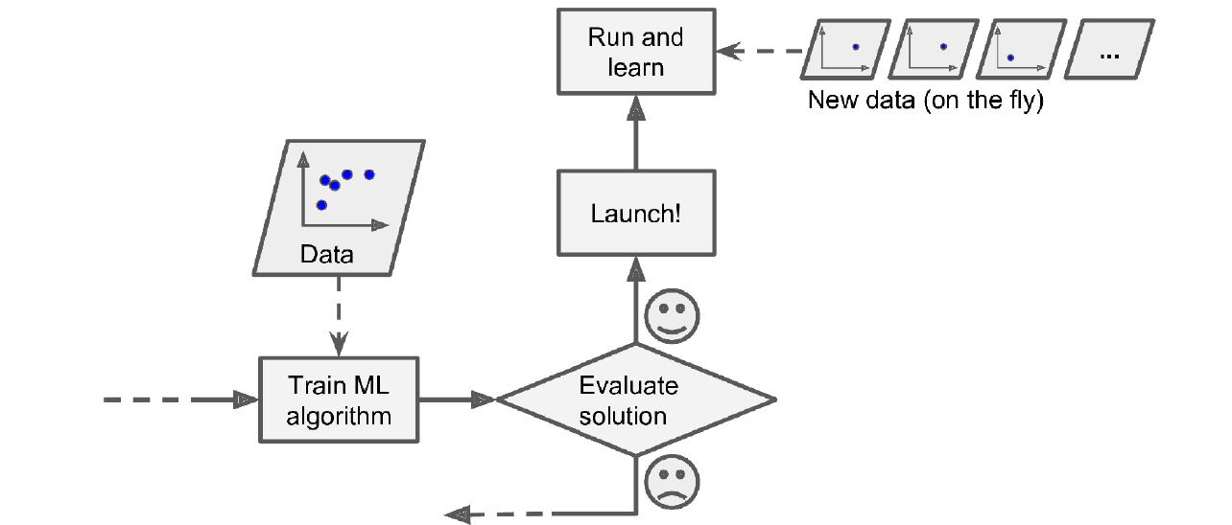
Online learning
Train the system incrementally by feeding it data instances sequentially, either individually or in small groups called mini-batches.
Each learning step is fast and cheap, so the system can learn about new data on the fly, as it arrives

Slide 7
Key Characteristics of Online Learning
Incremental learning:
The model learns continuously as new data arrives, updating its parameters after each instance or small batch.
Real-time adaptability:
Suitable for rapidly changing environments like stock markets or recommendation systems.
Memory efficiency:
After training on a data instance, the system can discard it, reducing storage demands.
Out-of-core capability:
Can handle datasets too large to fit in memory by processing data in chunks.

Slide 8
Key Characteristics of Online Learning
Learning rate sensitivity:
The degree to which the system adapts to new data depends on the learning rate; high rates enable fast adaptation but may forget old knowledge, while low rates retain stability.
Vulnerability to bad data:
Performance can degrade if noisy or corrupted data enters the system, so monitoring and rollback mechanisms are needed.

Slide 9
Online learning - Example
A stock price prediction system uses online learning to continuously adjust its predictive model as new price data streams in.
When market trends shift, the model quickly incorporates new information to stay accurate.
If a temporary anomaly occurs (like a sensor glitch or data spike), a well-tuned low learning rate helps prevent drastic reactions.

Slide 10
Online learning
Advantages
Adapts quickly to new or changing data patterns.
Efficient use of memory and storage; old data can be discarded.
Suitable for large-scale, streaming, or real-time applications.
Enables continuous, autonomous model improvement without retraining from scratch.
Disadvantages
Requires careful tuning of the learning rate to balance adaptability and stability.
Vulnerable to degraded performance from bad or noisy data.
Difficult to reproduce exact past states once data is discarded.
Needs ongoing monitoring and potentially rollback mechanisms to maintain reliability.

Slide 11
Aspect | Batch Learning | Online Learning
Training Process | Trains on entire dataset at once, offline; retrains from scratch for updates. | Learns incrementally as data streams in; updates model continuously.
Data Handling | Requires all data in memory; resource-heavy for large datasets. | Processes data in chunks; discards after use (memory-efficient).
Adaptability | Slow to adapt; periodic retraining (daily/weekly). | Rapid adaptation to changes; real-time updates.
Resource Use | High CPU/memory/disk; costly for frequent retraining. | Lower resources; suitable for limited hardware (e.g., mobile).
Example | Spam classifier retrained weekly on full email dataset. | Stock price predictor updating with live market data.
Key Parameter | None specific; focuses on full epochs. | Learning rate (high = fast adapt, forgets old; low = stable, slow).
Risks | Inefficient for fast-changing data; can't handle huge datasets easily. | Vulnerable to bad data; needs monitoring/rollback.

Slide 12
Instance-Based Versus Model-Based Learning
Machine Learning systems generalise to unseen data using two primary approaches:
Instance-based learning
Instance-based learning stores training examples in memory and generalizes to new cases by comparing similarity, such as word overlap for spam detection, rather than building an explicit model.
Model-based learning
Model-based learning builds a compact mathematical model from training examples to capture patterns, then uses that model for predictions on new data without storing originals.

Slide 13
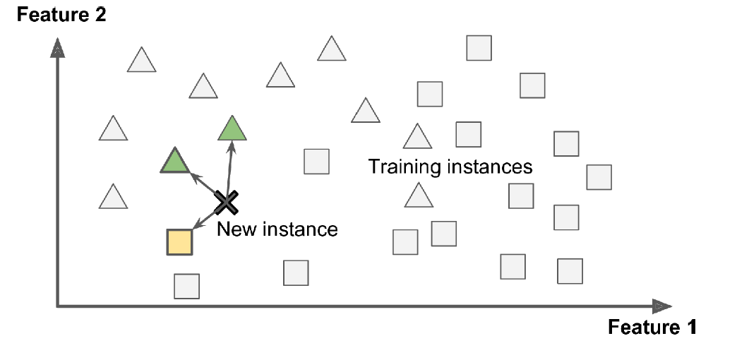
Instance-Based Learning

Slide 14
Key Characteristics of Instance-Based Learning
Stores all training data (lazy learning)
No model built upfront—computation happens at prediction time.​
Uses similarity measures
(e.g., word count overlap, Euclidean distance) to find closest matches.​
Scales with dataset size
Classifies new instances by majority vote of similar stored examples.​
Examples
Spam filter: Flags emails with many common words to known spam, beyond exact matches.​
k-Nearest Neighbors (k-NN): Classifies a new point (e.g., triangle) by majority of k closest training instances.​

Slide 15
Instance-Based Learning
Advantages
Adapts easily to new data without retraining; handles complex patterns.​
Simple implementation; no assumptions about data distribution.​
Disadvantages
High storage and computation for large datasets (O(n) per prediction).​
Sensitive to noise and irrelevant features; struggles with high dimensions.​

Slide 16
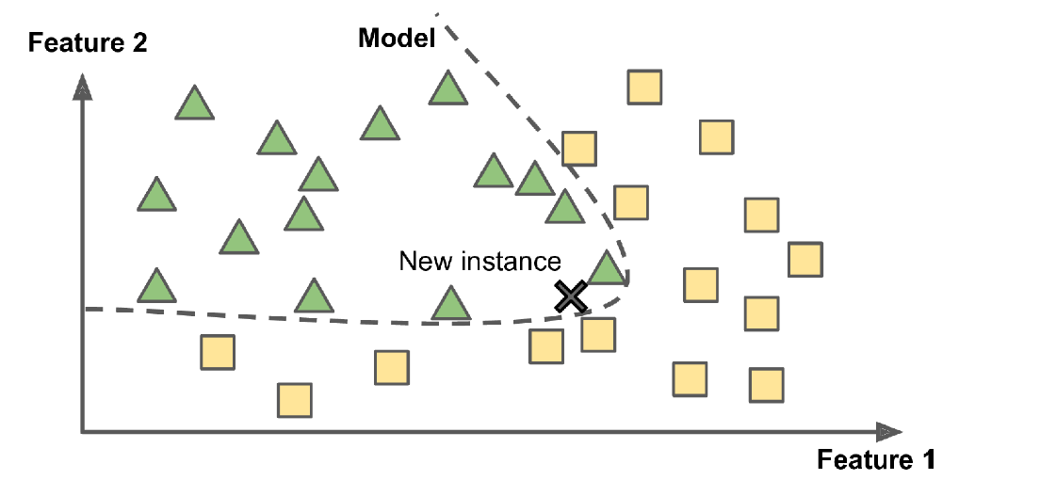
Model-based learning
Key Characteristics
Builds an explicit model from training data to represent underlying patterns and relationships.​
Training phase intensive; learns parameters/functions before prediction.​
Fast predictions using the compact model, independent of full dataset size.​

Slide 17
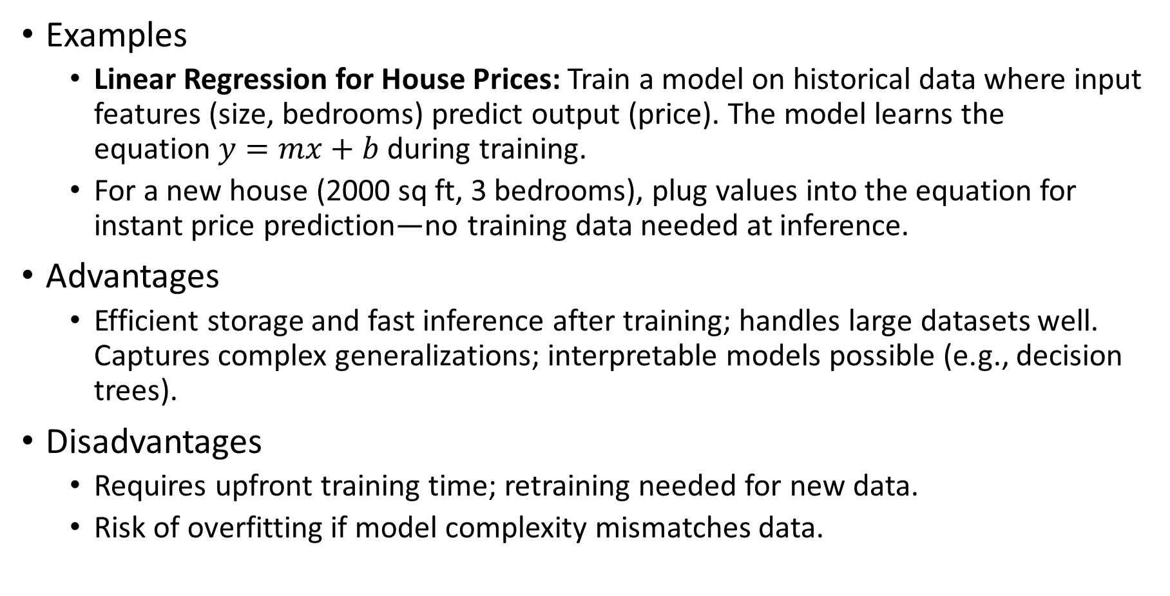
Model-based learning
Examples
Linear Regression for House Prices: Train a model on historical data where input features (size, bedrooms) predict output (price). The model learns the equation $y=mx+b$ during training.​
For a new house (2000 sq ft, 3 bedrooms), plug values into the equation for instant price prediction—no training data needed at inference.
Advantages
Efficient storage and fast inference after training; handles large datasets well.​ Captures complex generalizations; interpretable models possible (e.g., decision trees).​
Disadvantages
Requires upfront training time; retraining needed for new data.​
Risk of overfitting if model complexity mismatches data.

Slide 18
Aspect | Instance-Based Learning | Model-Based Learning
Approach | Stores training data; compares at prediction | Builds explicit model/parameters
Training | None (lazy); just memorizes data | Intensive; learns patterns/functions
Prediction Speed | Slow (searches all data each time) | Fast (uses compact model)
Storage | High (keeps all training data) | Low (discard data post-training)
Adaptability | Easy to new data; no retraining | Requires retraining for updates
Strengths | Handles complex boundaries; simple | Efficient; interpretable models possible
Weaknesses | Computationally expensive; noise-sensitive | Risk of overfitting; training cost

